Slide 1
Module 6 Class Problems
Part 1 Solar-Thermal Systems

Slide 2
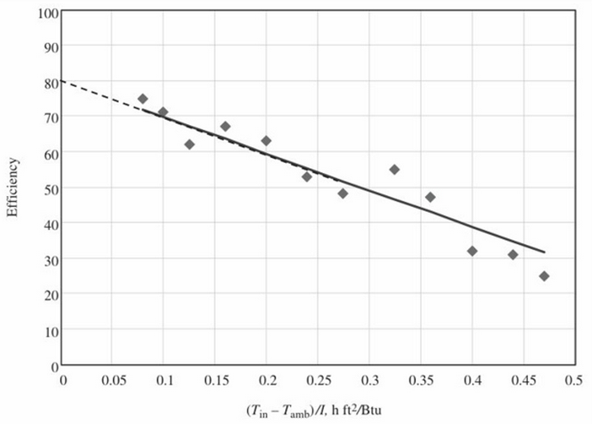
Q1. Figure below provides the results of a performance test for a single-glazed flat-plate collector. The transmissivity, τ, of the glass is 0.90, and the absorptivity, α, of the surface is 0.92.
For the collector, find:
The collector heat removal factor, F_{R}
The overall conductance, U_{L} in Btu/ft^{2 o}F.
The rate at which the collector can deliver useful energy when
the irradiation incident on the collector per unit area is 200 Btu/ft²h,
the ambient temperature is 30 F, and the inlet water temperature is 60 F.
(d) The collector temperature when the flow rate is zero (h = 0).
(e) If the water flow rate is 0.1 ft³/min, determine the temperature increase
for the water passing through the collector

Slide 3
Q2. Evaluate the performance of an Alternate Energy Technologies AE-21E solar collector on January 21 if the collector is located at 32° north latitude and tilted at an angle of 32°. The water inlet temperature is 58° F. The ambient temperature varies from 25° F at 8 a.m. to 45° F at solar noon to 35° F at 4 p.m. (assume even distribution from 8am to noon and noon to 4pm). Determine the efficiency, the hourly solar energy collected, and the percentage of incident solar energy collected all at solar noon.
In a spreadsheet, determine the hourly efficiency, the hourly solar energy collected, daily energy collected, and the percentage of incident solar energy collected considering the operation from 8am-4pm.

Slide 4
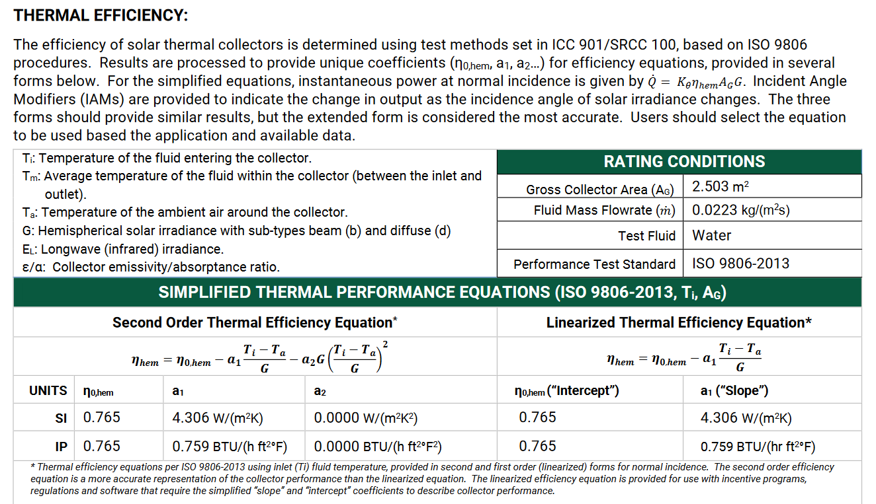
Q3. Evaluate the performance of a Heliodyne Gobi 408 flat-plate solar collector (performance characteristics available from the SRCC website) for Jun 21 at 40° north latitude. The water inlet temperature is 58° F, and the ambient temperature varies from 25° F at 7 a.m. (solar time) to 45° F at solar noon to 35° F at 5 p.m. (solar time). The collector is inclined at 30° from the horizontal. Metrics of interest include the hourly efficiency, the hourly solar energy collected, and the percentage of solar energy capture

Slide 5
Q4. A rudimentary Solar Electric Generating Station (SEGS) system consists of 2500 heliostats, each of 10 m², focusing on a central tower. The tower-heliostat system is able to transfer 50% of the incoming solar energy to incoming water, which then boils and is transferred to the turbine. Ignore other losses between the heliostats and expansion in the turbine. The plant averages 10 h/day of operation year-round, and during that time the incoming sun averages 400 W/m². Ignore losses of insolation due to the heliostats not facing in a normal direction to the sun. Before entering the tower, the water is compressed to 20 MPa. In the tower it is then heated to 700°C. The superheated steam is then expanded through the turbine using a basic Rankine cycle, and condensed at 5 kPa. Assume that the actual efficiency achieved by this cycle is 85% of the ideal efficiency. The generator is 98% efficient. What is the annual electric output in kWh/year?

Slide 6
Q5. The cost of the facility in the previous problem is $15 million (assuming that mass production has brought the cost down from the current cost of such experimental facilities), and it has an expected life of 25 years with no salvage value. If the MARR is 5%, what is the levelized cost of electricity from the system in $/kWh? Ignore the portion of electricity used onsite (also known as parasitic loads), and ignore maintenance and other costs.

Slide 7
Module 6 Class Problems
Part 2 Solar PV

Slide 8
Q1. What is the maximum wavelength of the light that produces voltage in a cadmium telluride (CdTe) and cadmium sulfide (CdS) photovoltaic device?

Slide 9
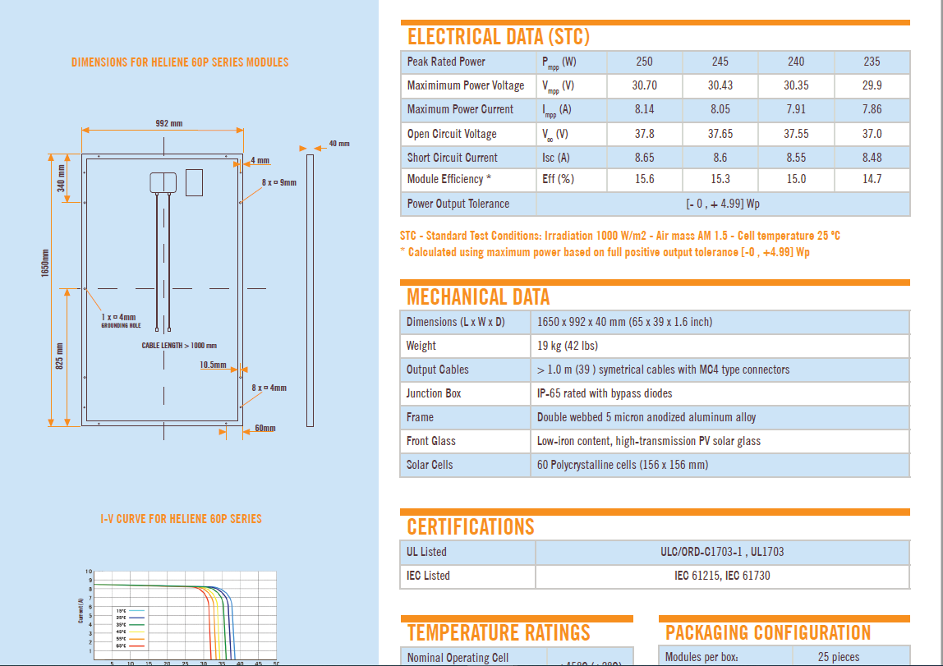
Q2. Given the technical specification sheet provided for Heiliene 60P, 250 W panel, determine the fill factor and validate the efficiency reported in the data sheet.

Slide 10
Q3. Photowatt class Ah photovoltaic cells are to be arranged to provide an output of 12 V and a power of 120 W. Recommend an arrangement that meets the specifications

Slide 11
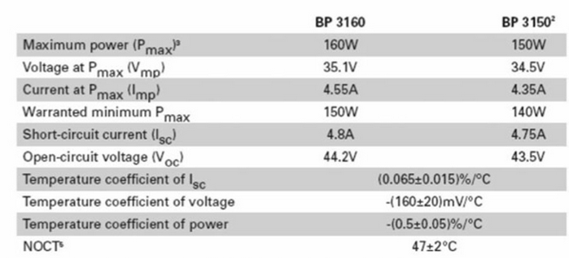
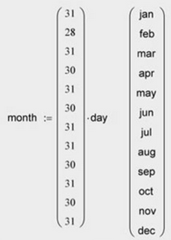
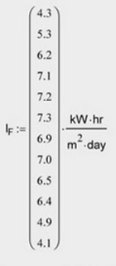
Q4. Part a) Estimate the daily average energy produce by an array consist of twenty BP 3160 modules for a day in July at a location with daily average solar irradiation given below.
Part b) Develop a spreadsheet and estimate annual kWh production of one BP E160 module for this location
Part c) If the feed-in tariff (i.e., the price local power provider would pay to purchase the electricity produced by renewable energy and fed into the local grid) is 0.81 $/kWh, estimate the generated revenue.

Slide 12
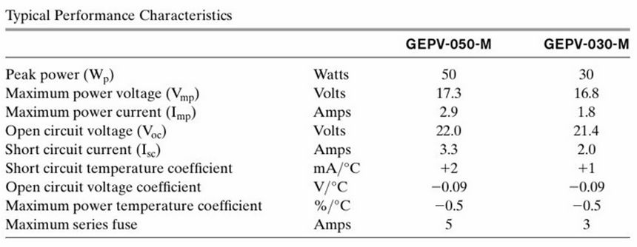
Q5. WithaGEPV-030-Mphotovoltaicmodule(characteristics in the following table), how many modules in what arrangement would be required to provide 100 V and 900 W at the rated conditions?

Slide 13
Q6. You are to evaluate a solar PV investment in a sunny location where each 1 kW of capacity generates on average 115 kWh/month year-round. The system size is 5 kW rated, and electricity in the region costs $0.12/kWh. You will finance the entire cost of the system with a loan, and thanks to an interest rate buy down, you are able to obtain the loan at 4% interest. There is a fixed cost of $5000 for the system for which no rebates or tax incentives are available; however, there are rebates available for the PV panels as a function of the number of watts of capacity installed. The cost of the panels is $6/W. Assume an investment lifetime of 20 years, and that the price of electricity remains constant, as measured in constant dollars. What is the dollar amount of rebate required per watt for the system to exactly break even over its lifetime?

